Slide 1

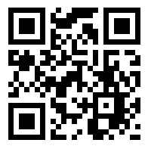
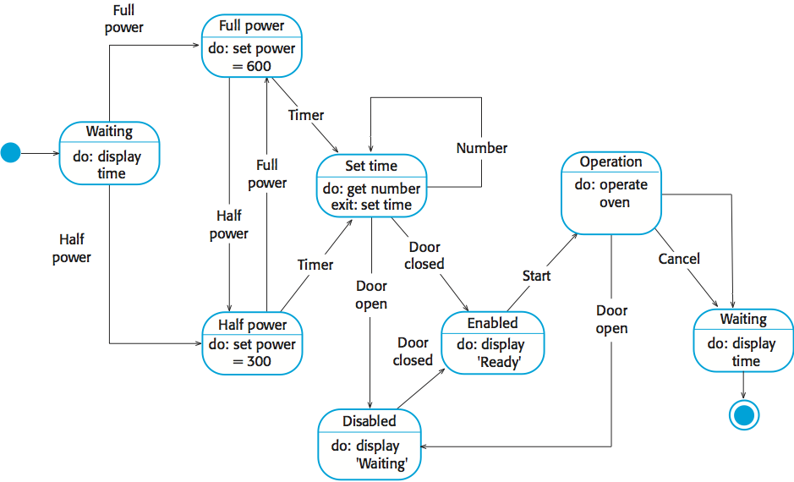
Research: A short summary of your research providing key related works; Be critical. Use appropriate citation.
UFCFXK-30-3: Digital Systems Project
Student name: Jacob Allen
Project Title: Snap Challenges – Photography Gamified App
A QR Code link to your video submission
Abstract:
This project is focussed on developing a cross platform app, using react native, the app will utilise gamification techniques to such as challenges to engage photographers with their craft. There will also be a slight educational focus as camera info and settings will also be shown if available from the images meta data or specified by the user.
Design, Implementation & Testing
State Diagram
Aims and objectives:
AIMS:
To develop a platform independent app to gamify photography via the use of challenges.
To minimise burn out amongst photographers using these challenges to engage them with the app and their hobby.
To educate the users of the app by providing information about the camera settings used to achieve the resulting photo.
OBJECTIVES:
Research gamification benefits and drawbacks, and other times it has been used in the photography field.
Research React Native in comparison to Progressive Web Apps (PWAs).
Research data storage solutions MYSQL vs NOSQL.
Design and develop the database schema.
Design and develop the Python Flask API.
Design and develop the front-end client as either a React Native app or PWA.
Test the system from both a technical and user perspective.
Produce a report to summarise findings, research, implementation, and testing stages of development.
Implementation artefacts (if any)
Can include other diagrams that verify the implementation process (e.g. class diagram etc.)
or
A screenshot of your GUI or ‘code output so far’ or similar
Testing
Details regarding your testing strategy
Planning and Management: This section will include your planning and management.
Key requirements:
Provide key requirements with short description if required.
Functional
The tool must blah blah
The tool must blah blah blah
The tool should blah blah blah
The tool should blah blah blah
The tool would blah blah blah
Non-functional
The tool must blah blah blah
The tool must blah blah blah
The tool should blah blah blah
The tool should blah blah blah
The tool would blah blah blah
References: References and citations should be in UWE Harvard style

